Slide 1

DAYANANDA SAGAR UNIVERSITY
ADA PROJECT

Slide 2
TOPIC
TEXT COMPRESSION USING HUFFMAN CODING

Slide 3
INTRODUCTION
The human world is currently undergoing intense technological revolution. There is need for maintaining large volume of data or information and storing them. But maintaining such large data is not an easy task as the time and storage available is limited. Hence, storing and managing of the data has to be done in an efficient manner. Therefore, data compression is one of the techniques used to store data in a limited space. Hence, Data compression using Huffman compression is one of the techniques to tackle efficient storage management.

Slide 4
PROBLEM STATEMENT
The text compression problem using Huffman code aims to reduce the number of bits used by each character.
Each character having ASCII value uses fixed 8 bits which is not very efficient hence the text has to be compressed in such a way that it uses fewer bits of data. This is achieved using Huffman codes obtained by prioritizing the characters based on the occurrences of each character and encoding the character string which is compressed and gives the encoded compressed bits as an output.

Slide 5
OBJECTIVES
Huffman coding is extensively used to compress bit strings representing text and it also plays an important role in compressing audio and image files.
Huffman coding, an algorithm for the lossless compression of files based on the frequency of occurrence of a symbol in the file that is being compressed.
Huffman coding assigns codes to characters such that the length of the code depends on the relative frequency or weight of the corresponding character. Huffman codes are of variable-length, and prefix-free (no code is prefix of any other).
Based on the symbols and their frequencies, the goal is to construct a rooted binary tree where the symbols are the labels of the leaves.
The principle is to use a lower number of bits to encode the data that occurs more frequently.

Slide 6
PROJECT REQUIREMENTS
HARDWARE REQUIREMENTS
Processor: intel(R)Core (TM) i5-8250U
RAM: 8.00GB
SOFTWARE REQUIREMENTS
Programming language: C programming
Operating system: Windows 10/Ubuntu
Compiler used: GNU-GCC COMPILER

Slide 7
FLOWCHART

Slide 8
START
INPUT DATA WITH FREQUENCY
FORM A MINIMUM PRIORITY QUEUE FOR THE FREQUENCIES
WHILE LENGTH OF PRIORITY QUEUE>1
TAKE THE 1ST TWO ELEMENTS AND START BUILDING THE TREE AND RETURN ROOT
IN THE FORMED BINARY TREE ASSIGN VALUES 1 TO EVERY LEFT NODE & 0 TO EVERY RIGHT NODE RESPECTIVELY
TRACE FROM EACH LEAF NODE & FIND BINARY CODE OF EACH CHARACTER
STOP

Slide 9
FUNCTIONS
node new_node(int freq, char c, node a, node b) // Reads through the given input and forms list of characters and frequency.
void qinsert(node n); //This function creates a priority queue.
Higher frequency has lower priority move up lower frequency.
Compare frequency of the new node with the parent's frequency.
node qremove(); //Remove the top element and moving up other elements. void build_code(node n, char *s, int len) // This function traverses the tree and assign 0’s to right nodes and 1’s to the left nodes.
void build_code(node n, char *s, int len); // This function traverses the tree and assigns the accumulates as 0’s to right nodes and 1’s to the left nodes vice versa also works well.

Slide 10
FUNCTIONS
void init(const char *s) //count frequency for each character and completes the heap while merging node staring from the lower frequency nodes
This is done in the following steps
(1) Remove top two nodes which have the highest priority (lowest frequency)
(2) Make a new one with the two removed nodes while adding the two frequency
(3) When we make the new node, it remembers its children as left/right nodes
(4) Keep merging the nodes until there is only one node left.
void encode(const char *s, char *out); // encodes the final binary codes of each character.
void decode(const char *s, node t); // decodes the give binary code for the string and gives back the same string if the code is correct.

Slide 11
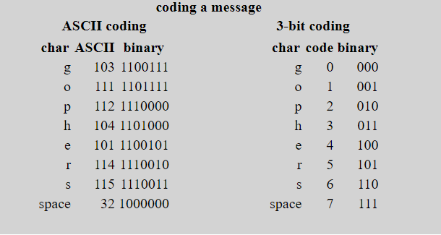
This is an example string “go go gophers” is encoded using ASCII and Huffman code. The ASCII encoding(8 bits per character) takes 104bits whereas Huffman encoding is uses fewer bits.

Slide 12
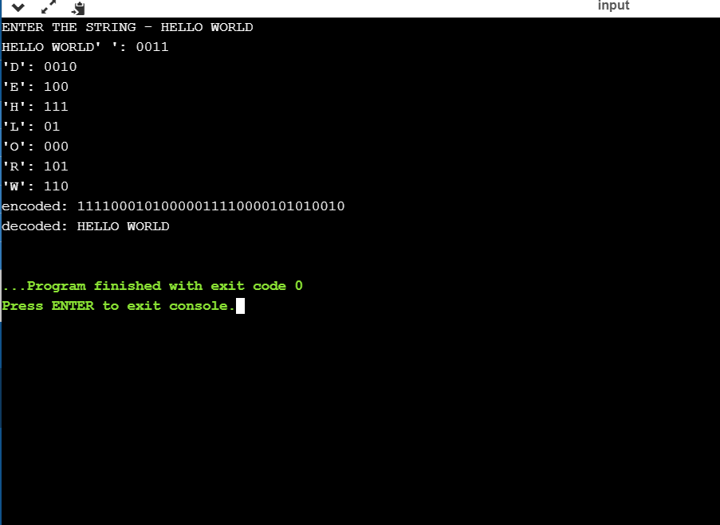
OUTPUT

Slide 13
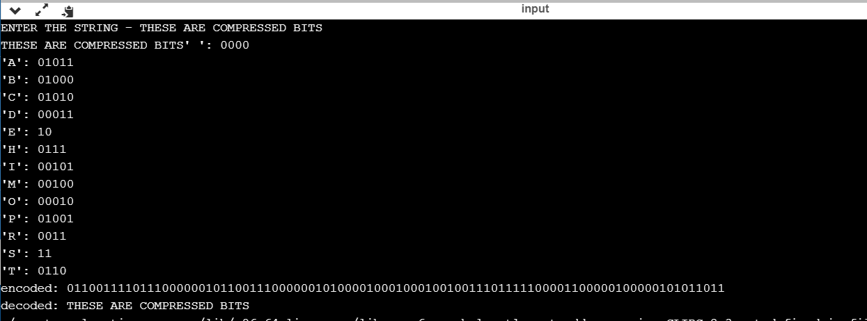

Slide 14
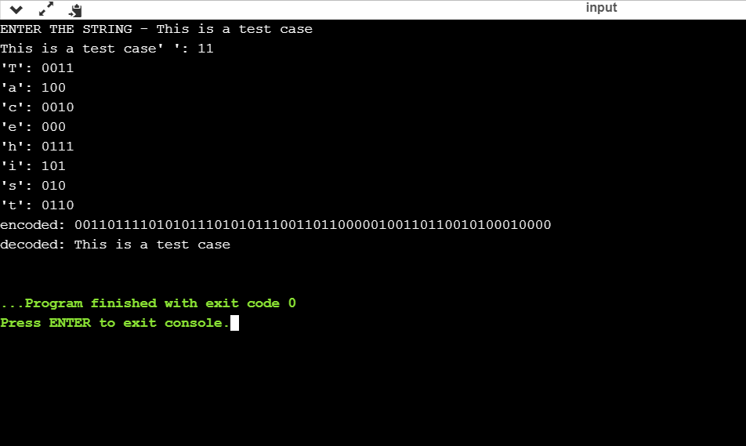

Slide 15
APPLICATIONS
Both the .mp3 and .jpg file formats use Huffman coding at one stage of compression.
Alternate method that achieves but is slower is patented by IB, making Huffman codes attractive.
An application that uses several data structures.
Huffman coding is still one of the best compression industries has the newer arithmetic and range coding schemes are avoided due to their parent issues.

Slide 16
SUBMITTED BY :
SAHANA H P ( ENG18CS0239)
SANJANA A G ( ENG18CS0244)
RACHIT POTLURI (ENG18CS0220)
SAHANA M (ENG18CS0240)

